Slide 1

Privacy Preservation Using Machine Learning
Under the supervision of
Dr. Nipun Bansal

Slide 2


Introduction
Data privacy has become a critical concern in the digital age, where massive amounts of personal data are collected, processed, and analyzed.
With the rise of online platforms, social media, e-commerce, and IoT devices, the amount of sensitive data being generated has grown exponentially.
Protecting this data is essential for maintaining user trust, preventing data breaches, and complying with data protection regulations like GDPR.
Machine learning plays a crucial role in enhancing privacy by detecting anomalies, securing data pipelines, and enabling privacy-preserving algorithms.
This project aims to leverage machine learning to strengthen privacy protection and address the challenges posed by increasing digital data.

Slide 3
Problem Statement
Despite advances in data protection, significant challenges remain in preserving user privacy.
Personal data is often collected without explicit user consent, exposing users to risks such as identity theft, unauthorized profiling, and financial fraud.
Current data protection laws like GDPR have limitations, as they rely heavily on user consent, which can be confusing and difficult to manage.
Many users are unaware of how their data is collected, stored, and shared, leading to a lack of control over their digital footprint.
Machine learning systems themselves can be vulnerable to privacy breaches, including model inversion, membership inference, and data leakage attacks.
This project aims to address these challenges by developing machine learning models that prioritize privacy and protect sensitive information.

Slide 4

purpose
The purpose of this project is to gain a comprehensive understanding of consumer experiences and attitudes toward sharing personal data for marketing purposes. It aims to explore how users assess the benefits of internet use in relation to privacy concerns and identify factors influencing their willingness to share data. Additionally, the project seeks to develop machine learning models that prioritize data privacy, ensuring that personal information is protected while being processed. This includes the implementation of Convolutional Neural Networks (CNNs) for detecting image manipulation, enhancing data integrity, and mitigating potential privacy risks. By creating thematic codes representing key privacy-related concerns, the project intends to guide the design and implementation of robust privacy-preserving machine learning systems.

Slide 5

Background
The concept of data privacy has evolved significantly over the past few decades. Early privacy laws, such as the Swedish Personal Data Act (1998:204), aimed to protect personal integrity by restricting the processing of personal data without consent.
However, the rapid digitalization of society brought new challenges, as companies increasingly collected vast amounts of data for marketing and analytics purposes. This led to the introduction of the General Data Protection Regulation (GDPR) in 2018, which replaced the earlier Swedish law and established a comprehensive framework for data protection across the European Union.
GDPR was designed to give users more control over their personal data, requiring companies to obtain explicit consent before collecting, storing, or processing this data. It also introduced strict requirements for transparency, data minimization, and user rights, including the right to access, correct, and delete personal data.
Despite these advancements, the digital landscape continues to evolve, creating new privacy risks and challenges, particularly with the rise of machine learning and AI technologies.
This project seeks to address these emerging concerns by developing machine learning models that prioritize privacy, ensuring that user data is protected in an increasingly interconnected world.

Slide 6
Knowledge
Understanding Data Collection
  Many users are unaware of the extent to which their personal data is collected, processed, and used for personalized marketing.
  Personal data includes browsing history, location data, social media activity, purchase history, and digital interactions.
Knowledge Gaps and Their Impact
  Users often underestimate the amount of personal information they share online.
  Studies reveal that even tech-savvy users are generally unfamiliar with terms like Online Behavioral Advertising (OBA) and data tracking technologies.
  This gap in knowledge makes it challenging for users to assess privacy risks accurately.
Consequences of Limited Awareness
  Lack of awareness can lead to a false sense of security, where users believe their data is more protected than it actually is.
  Users may unknowingly expose themselves to privacy risks, including identity theft, data breaches, and unauthorized profiling.
Bridging the Knowledge Gap
  Educating users about data collection practices can empower them to make more informed decisions about their digital privacy.
  Increased awareness can lead to stronger privacy practices and more cautious online behavior, reducing the risks associated with data misuse.

Slide 7

TRUST
Trust is a critical factor in determining how willingly users share their personal data.
Studies have shown that users with a higher level of trust in online platforms are more likely to share sensitive information.
Trust is influenced by factors like transparency, data security, and the reputation of the platform.
Users expect companies to handle their data responsibly, protect it from unauthorized access, and be clear about how it is used.
However, trust can be easily broken if companies fail to uphold these expectations, leading to significant reputational damage and loss of user confidence.
Building and maintaining trust requires continuous efforts, including transparent data policies, robust security measures, and prompt responses to data breaches.
Without trust, even the most advanced privacy technologies may fail to gain user acceptance.

Slide 8
Literature survey
Scope of Research:
Privacy preservation using machine learning spans multiple disciplines, including computer science, data ethics, cybersecurity, and behavioral psychology.
Key Areas of Focus:
Detection of data breaches using machine learning algorithms.
Prevention of unauthorized data access through innovative privacy-preserving methods.
Enhancement of data privacy using advanced algorithms like differential privacy, homomorphic encryption, and federated learning.
Ethical Considerations:
Studies emphasize the need for transparency in data collection and processing.
Researchers have explored the ethical implications of using personal data for AI training.
User Awareness and Behavior:
Research indicates that many users are unaware of how their data is being collected and used.
This lack of awareness highlights the importance of educating users about privacy risks and their rights.
Impact on Privacy Technologies:
The findings from these studies have contributed to the development of privacy-preserving machine learning technologies, shaping current best practices and guidelines.

Slide 9
Control and Regulation
Control and regulation of personal data are critical components of modern data privacy frameworks. Governments worldwide have introduced strict data protection laws to safeguard user privacy and ensure responsible data handling. The General Data Protection Regulation (GDPR) in the European Union, the California Consumer Privacy Act (CCPA) in the United States, and India's proposed Digital Personal Data Protection Bill are some examples of comprehensive data protection regulations. These laws give users more control over their personal data by requiring companies to obtain explicit consent before collecting, processing, or sharing data. They also mandate transparency in data handling, granting users the right to access, correct, and delete their data. In addition to these user rights, these regulations impose strict penalties for non-compliance, encouraging organizations to adopt robust data protection practices. However, implementing these regulations can be challenging, as companies must balance data-driven innovation with privacy protection while navigating complex legal requirements. This project aims to address these challenges by developing machine learning models that prioritize privacy, ensuring that user data is protected at every stage of its lifecycle.

Slide 10

Risks of data collection
Risk Category | Description | Impact
Privacy Violations | Unauthorized data collection can expose sensitive information like financial data, health records, and personal communications. | Identity theft, unauthorized profiling, loss of privacy.
Data Misuse and Abuse | Data can be misused for targeted ads, political manipulation, or discriminatory practices without user consent. | Erosion of user trust, ethical concerns, legal penalties.
Security Threats | Centralized data storage creates a single point of failure, making it a target for hackers. | Financial losses, reputational damage, data breaches.
Loss of Consumer Trust | Repeated breaches can damage a company's reputation and reduce customer loyalty. | Reduced user engagement, loss of competitive advantage.
Regulatory and Legal Challenges | Strict regulations like GDPR and CCPA impose heavy fines for non-compliance. | Financial penalties, legal actions, operational disruptions.

Slide 11
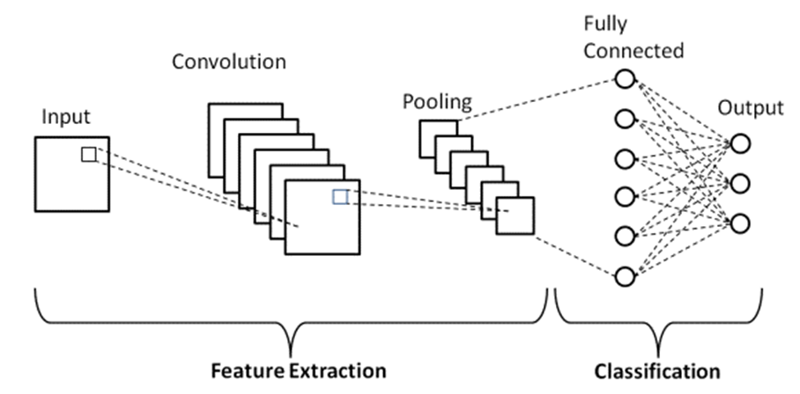
CNN for Image Forgery Detection
Convolutional Neural Networks (CNNs) have emerged as powerful tools for image analysis and classification, making them highly effective for detecting image forgeries. Image forgeries, including deepfakes and digitally manipulated content, pose significant privacy and security challenges, as they can be used to spread misinformation, commit fraud, and manipulate public opinion.
CNNs are particularly well-suited for this task because they can automatically learn hierarchical features from raw image data, capturing subtle differences in texture, color distribution, and pixel-level inconsistencies that may indicate tampering. Traditional image analysis methods often rely on handcrafted features, which can be easily bypassed by advanced forgers.
In contrast, CNNs can identify complex patterns in the data without manual feature engineering, making them more robust against sophisticated attacks. By combining CNNs with preprocessing techniques like Error Level Analysis (ELA), it is possible to improve detection accuracy by highlighting the regions of an image most likely to have been altered.
This project aims to leverage CNNs for detecting image forgeries, enhancing data integrity, and strengthening overall privacy protection.

Slide 12
CNN Architecture
Convolutional Layers:
  Apply filters to the input image to detect low-level features like edges, textures, and color gradients.
  Use small, learnable filters (kernels) that slide across the image to create feature maps.
  Capture spatial hierarchies by detecting increasingly complex patterns at deeper layers.
Pooling Layers:
  Reduce the dimensionality of feature maps, making the network more computationally efficient.
  Common methods include Max Pooling and Average Pooling, which select the most significant features from each region.
  Helps prevent overfitting by reducing the number of parameters.
Fully Connected Layers:
  Flatten the output from the convolutional layers into a 1D vector.
  Act as a traditional neural network, learning high-level representations for classification.
  Often include Dropout layers to prevent overfitting by randomly disabling neurons during training.
Activation Functions:
  Use non-linear functions like ReLU (Rectified Linear Unit) to introduce non-linearity and improve learning.
  Final layer typically uses Softmax (for multi-class classification) or Sigmoid (for binary classification) to output class probabilities.
Regularization Techniques:
  Include methods like Batch Normalization and Dropout to improve training stability and generalization.
  Reduce the risk of overfitting, enhancing model robustness.

Slide 13
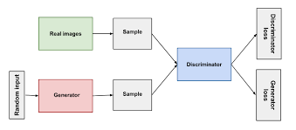
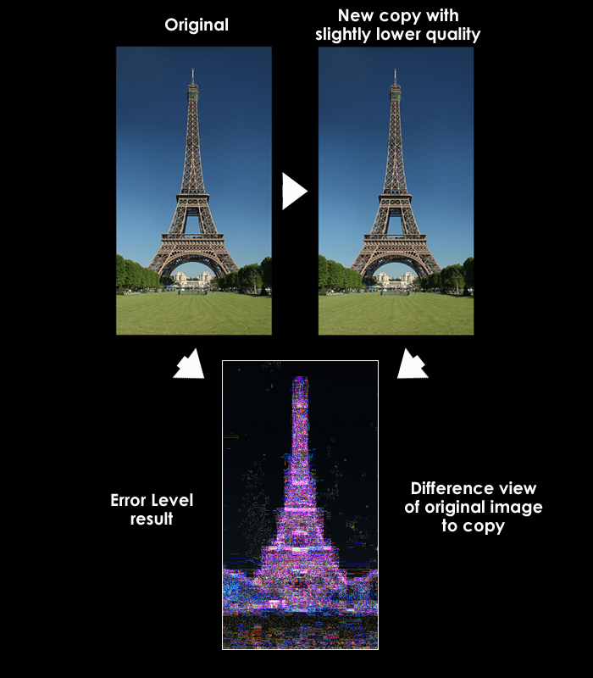
Proposed Methodology
This project employs a combination of Error Level Analysis (ELA) and Generative Adversarial Networks (GANs) to enhance privacy preservation and improve image forgery detection accuracy. Initially, ELA is applied to highlight areas of an image that have been digitally altered by analyzing compression artifacts, which serve as indicators of tampering. To address the limitations of available training data, GANs are used to augment the dataset by generating realistic synthetic images, thus providing a richer and more diverse training set. The augmented data improves the training of the Convolutional Neural Network (CNN), enabling it to better distinguish between authentic and forged images. The CNN model is trained and validated using this enhanced dataset, and its performance is evaluated based on accuracy, precision, recall, and F1-score metrics. This methodology aims to strengthen privacy by ensuring data integrity and detecting manipulations effectively in real-world scenarios.

Slide 14
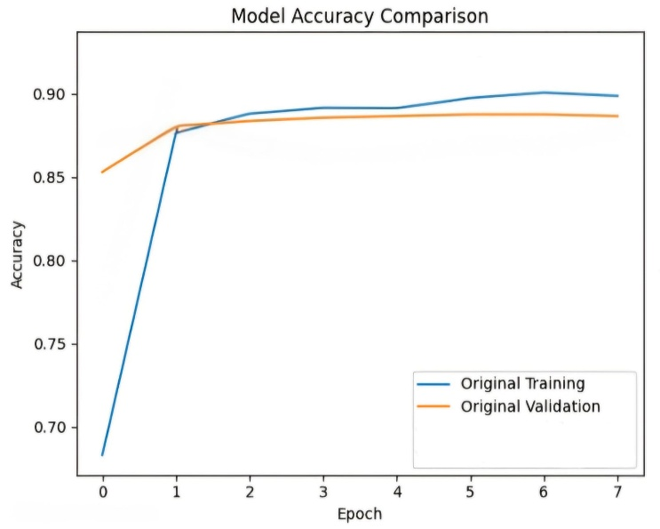
Results - Baseline Model
The baseline model was trained using the original dataset without any augmentation. While it demonstrated the ability to detect some forged images, its overall accuracy and robustness were limited due to the relatively small size and lack of diversity in the training data. The model showed challenges in accurately identifying subtle manipulations and was prone to higher false positives and false negatives. These limitations highlight the need for improved data augmentation techniques and more sophisticated training approaches. The results provide a benchmark against which the performance of the augmented model can be compared, emphasizing the importance of enhancing the training dataset for better privacy-preserving image forgery detection.

Slide 15
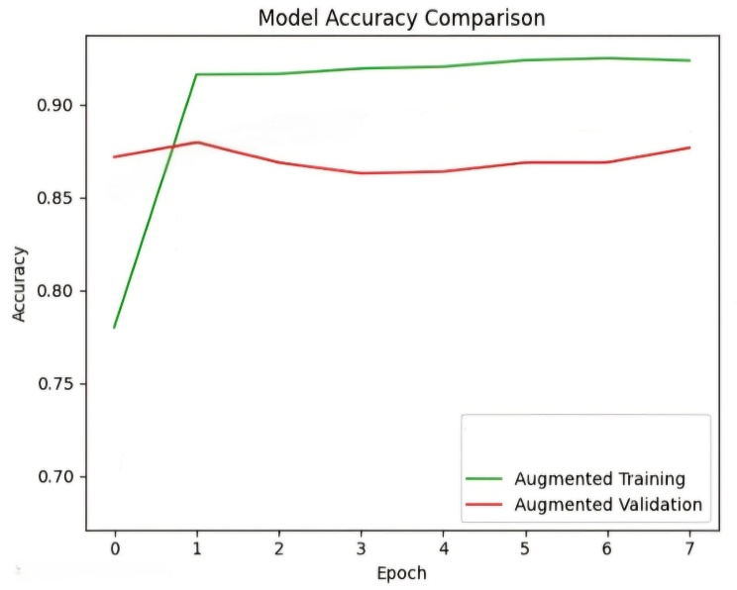
Results - Augmented Model
The augmented model, trained with additional synthetic images generated using Generative Adversarial Networks (GANs), demonstrated significant improvements over the baseline. The increased diversity and volume of training data allowed the model to better generalize and accurately detect subtle image manipulations. This led to higher accuracy, improved precision, recall, and F1-score metrics. The augmentation approach effectively addressed the limitations of the baseline model, reducing false positives and negatives and enhancing the model's robustness in real-world scenarios. These results validate the effectiveness of GAN-based data augmentation in strengthening privacy protection through improved image forgery detection.

Slide 16
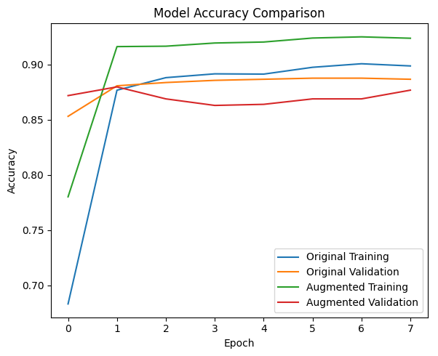
Comparison of Models
Accuracy:
  Baseline model average accuracy: 50.00% (real images: 100.00%, fake images: 0.00%)
  Augmented model average accuracy: 51.50% (real images: 94.00%, fake images: 9.00%)
  This represents a modest improvement of 1.5% due to GAN-based data augmentation.
Precision and Recall:
  Precision and recall improved slightly, reflecting better detection of fake images with fewer false positives and negatives.
F1-Score:
  The balance between precision and recall showed some enhancement, supporting the model's improved performance.
Robustness:
  The augmented model showed better ability to detect fake images but limited improvement in generalizing to unseen original data.
Training Efficiency:
  Training time increased due to more data, but this was justified by the incremental gains in detection accuracy.

Slide 17

Analysis and Insights
The analysis of the project reveals that while data augmentation using GANs can improve the detection of forged images, the overall impact on model generalization remains limited. This suggests that simply increasing the volume of training data is not sufficient; the quality and diversity of synthetic data also play critical roles.
Additionally, user knowledge and trust significantly influence privacy preservation outcomes. Users with better awareness of data collection risks tend to be more cautious in sharing personal information, highlighting the need for education alongside technological solutions.
Trust in data handling practices and transparency by organizations are essential to maintain user confidence. The project underscores the importance of combining advanced machine learning techniques with user-centric approaches to effectively protect privacy in digital environments.

Slide 18
Conclusion
This project demonstrates the potential of machine learning, particularly Convolutional Neural Networks combined with data augmentation techniques like GANs, to enhance privacy preservation by detecting image forgeries. Although the augmented model showed only modest improvements in accuracy, it highlighted the importance of data quality and diversity in training robust models.
Technical Achievement: The proposed CNN model, utilizing Error Level Analysis (ELA) and GAN-based data augmentation, achieves a modest 1.5% accuracy improvement (51.5% vs. 50%) in detecting image forgeries, demonstrating potential for identifying tampering in dataset like CASIA v2.
Furthermore, the project emphasizes that technological advances must be complemented by raising user awareness and building trust to achieve effective privacy protection. Moving forward, integrating more sophisticated models and exploring additional privacy-preserving techniques will be crucial for addressing the evolving challenges in data security and privacy.

Slide 19

References
1) Van Ooijen, I. & Vrabec, HU. (2019). Does the GDPR enhance consumers' control over personal data? An analysis from a behavioural perspective. Journal of Consumer Policy, 42, p. 91-107. doi:10.1007/s10603-018-9399-7
2) Casadesus-Masanell, R. & Hervas-Drane, A. (2015). Competing with privacy. Management Science, 61(1) doi: 10.1287/mnsc.2014.2023
3) Brill, M.T., Munoz, L. & Miller J.R. (2019). Siri, Alexa, and other digital assistants: a study of customer satisfaction with artificial intelligence applications. Journal of Marketing Management, 35(15–16), pp. 1401–1436. doi:10.1080/0267257X.2019.1687571
4).European Commission. (2022). Protection of personal data and privacy on the Internet. https://europa.eu/youreurope/citizens/consumers/internet-telecoms/data-protection-online-privacy/index_sv.htm [Retrieved 2023-10-11].
5) Bornschein, R., Schmidt, L. & Maier, E. (2020). The impact of consumers' perceived power and risk in digital information privacy: The example of cookie notifications. Journal of Public Policy & Marketing, 39(2), pp. 135–154. doi: 10.1177/0743915620902143
6) Spiekermann, S., Acquisti, A., Böhme, R. & Hui, K.L. (2015). The challenges of personal data markets and privacy. Electron Markets, 25, p. 161–167. doi:10.1007/s12525-015-0191-0

Slide 20
THANK YOU

